Slide 1

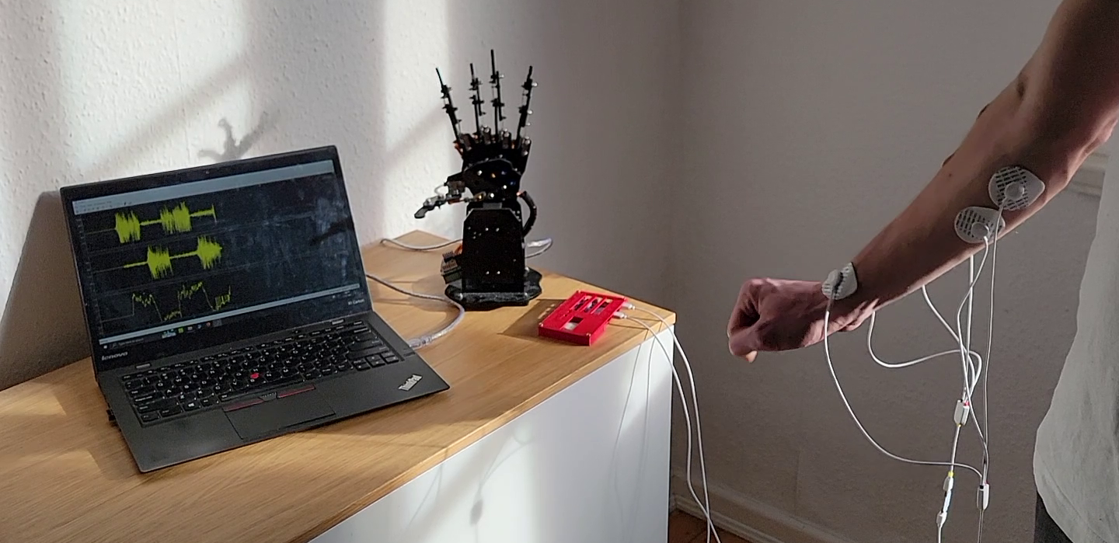
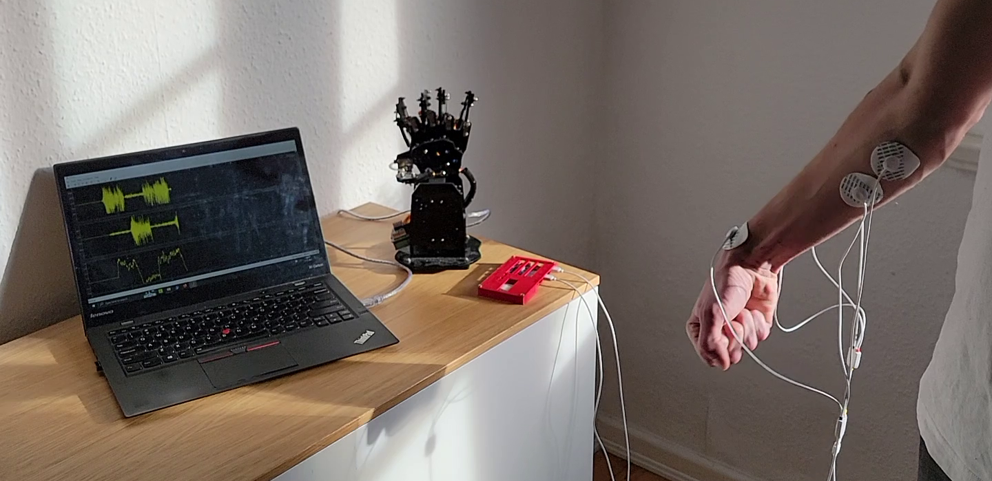
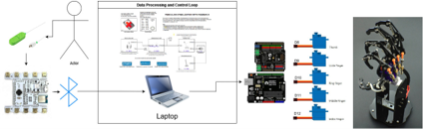
Development of an EMG Controlled Robot Hand
Damian Ascanio Hecker, Hendrik Bommer, Garrett Lundegard Department of Life Sciences HAW Hamburg, Research Seminar WiSe 2023
Introduction
Electromyography (EMG) allows muscle contraction to be measured and displayed as the voltage difference between electrodes over time. Acquisition of these EMG signals is of interest for the development of bionic prosthetics designed to mimic limb movement. In this project, a system for acquiring and processing EMG data for the purpose of controlling a robot hand is implemented. EMG signals from the forearm are acquired during wrist flexion and extension and a controller is programmed to open and close the robotic hand in response to these movements.
Results
Conclusions
Within this project a fully functional EMG controlled robot hand was built. The robot hand responds in its movement to a real time EMG signal and is insensitive towards interference movements. The observed delay between action and reaction is believed to be resulting from the Simulink processing time. The system can be run on any machine provided MATLAB and Simulink are installed, and Bluetooth connectivity is available. The design in both hardware and software is completely modular and forms a good basis for further development. Documentation and datasheets of the components used provide information for recreating and expanding this project.
A full system was set up using Simulink to acquire data from the BITalino and send a control signal to the Arduino in real-time. A series of wrist flexion and extension movements were performed over a period of 30 seconds. During the test, the raw data from the two EMG channels was acquired and processed into the control signal being sent to the robot hand. The resulting movements of the robotic hand and its correctness as well as robustness was confirmed through visual observation. A short delay between the movement by the test subject and the resulting robotic hand movement was observed.
Complete Test Setup – Wrist extension movement
Materials and Methods
The EMG data acquisition is done via a BITalino. The signals are recorded during flexion and extension of the wrist. Overall, four electrodes measure EMG signals from the musculus extensor digitorum and the musculus flexor digitorum superficialis, each pair coupled with a reference electrode. Simulink receives the data via Bluetooth serial communication. The data is decoded, filtered and converted into a control signal from –1 to +1. This control signal is sent to an Arduino over Serial USB. A positive signal opens the hand, and a negative signal closes the hand.
Complete Test Setup – Wrist flexion movement
Future Work
An extension of this project is the velocity and gripping force control of the robot hand. This could be achieved by extending the controller and Arduino code of the robot hand. Additionally, the control of single digits could be implemented. This would be possible by use of more electrodes and adjustments to data acquisition and processing or by extending the control protocol for the robot hand.
Acknowledgments
We would like to thank Prof. Wilke and Prof. van Stevendaal for the opportunity to work on such an interesting topic and for their continuous support.
Plots: Top – Raw EMG signal from the flexor muscles of the forearm. Middle – Raw EMG signal from the supinator muscles of the forearm. Bottom – resulting control signal sent to the robot hand after signal processing
Complete System Diagram

